Slide 1
E-commerce Business Models
and Concepts
Copyright © 2014 Pearson Education, Inc. Publishing as Prentice Hall

Slide 2
E-commerce Business Models
Business model
Set of planned activities designed to result in a profit in a marketplace
Business plan
Describes a firm’s business model
E-commerce business model
Uses/leverages unique qualities of Internet and Web

Slide 3
Eight Key Elements of a Business Model
Customer Value proposition
Revenue model
Market opportunity
Competitive environment
Competitive advantage
Market strategy
Organizational development
Management team

Slide 4
1. Customer Value Proposition
How does the product or service fulfill customer needs
Why customers will choose to business with your firm instead of another company
E-commerce value propositions:
Personalization/customization
Convenience
Price/No shipping cost
Quick delivery
Unparalleled Selection
Product/service quality
Examples:
Pizzahut Value Proposition - delivery of Pizza within 17 and half min.
Amazon Value Proposition – (Unparalleled Selection and Convenience) Amazon makes it possible for book lovers to shop for virtually any book in print from the comfort of their home or office, 24 hours a day and to know immediately whether a book is in stock or not.

Slide 5
2. Revenue Model
How will the company earn money (Profit / Return)
Major types of revenue models:
Advertising revenue model- Google, Yahoo, Facebook
Subscription revenue model –Anti virus, Consumer Reports, Wall Street News Subscription, Dropboox
Transaction fee revenue model- ebay, E-trade, Credit cards
Sales revenue model – Amazon, Dell.com, Acer.com, Sony.com
Affiliate revenue model – airlines/car rentals/hotels (Trivago, Food Panda)

Slide 6
3. Market Opportunity
The intended Marketspace of the company
Marketspace: Area of actual or potential commercial value in which company intends to operate
Realistic market opportunity: Defined by revenue potential in each market segment in which company hopes to compete
Market opportunity typically divided into smaller segments

Slide 7
4. Competitive Environment
Who else occupies your intended marketspace?”
Other companies selling similar products in the same marketspace
New entrants into market, substitute products, and power of consumers and suppliers (nature of competition)
For example, Priceline and Travelociy, both of whom sell discount airline tickets online, are direct competitors because both companies sell identical products – cheap tickets.
Includes both direct and indirect competitors
For instance, automobile manufacturers and airline companies operate in different industries, but they still compete indirectly because they offer consumers alternative means of transportation
Influenced by:
Number and size of active competitors
Each competitor’s market share
Competitors’profitability
Competitors’pricing

Slide 8
5. Competitive Advantage
The special advantages of a firm
Superior or cheaper product than competitors
What makes a product superior?
Important concepts:
Asymmetries exist when one competitor has more resources or differential access to them compared to other competitors
First-mover advantage
Unfair competitive advantage results from factors of production that are hard to duplicate or acquire (brands, natural resources, capital investments)
Leverage using vast resources to move in other markets – leveraging a large customer base, or lots of money (Apple car)
Perfect markets do not allow for competitive advantage as all firms have equal access to all factors of production

Slide 9
6. Market Strategy
How do you plan to promote your products or services to attract the target audience
Details how a company intends to enter market and attract customers
Best business concepts will fail if not properly marketed to potential customers -IBM OS 2

Slide 10
7. Organizational Development
The types of organizational structures within the firm necessary to carry out the business plan
Describes how firm will organize work
Typically, divided into functional departments, some organize around products, combination of both (auto manufacturers)
As company grows, hiring moves from generalists to specialists

Slide 11
8. Management Team
“What kind of backgrounds should the company’leaders have?”
A strong management team:
Make the business model work
Give credibility to outside investors
Has market-specific knowledge
Has experience in implementing business plans

Slide 12
Raising Capital
Seed capital personal funds used to start business
Traditional sources
Incubators provide small amount of funding and provide services to start-ups
Commercial banks
Angel investors wealthy investors who invest money in exchange for equity share of the business
Venture capital firms invest funds they manage for other investors
Strategic partners
Crowdfunding
Using internet to allow individuals to contribute to new ventures

Slide 13
Categorizing E-commerce Business Models
categorizes based on:
E-commerce sectors (B2B, and B2C)
E-commerce technology (e.g., m-commerce)
Similar business models appear in more than one sector
Some companies use multiple business models (e.g., eBay, Amazon)

Slide 14
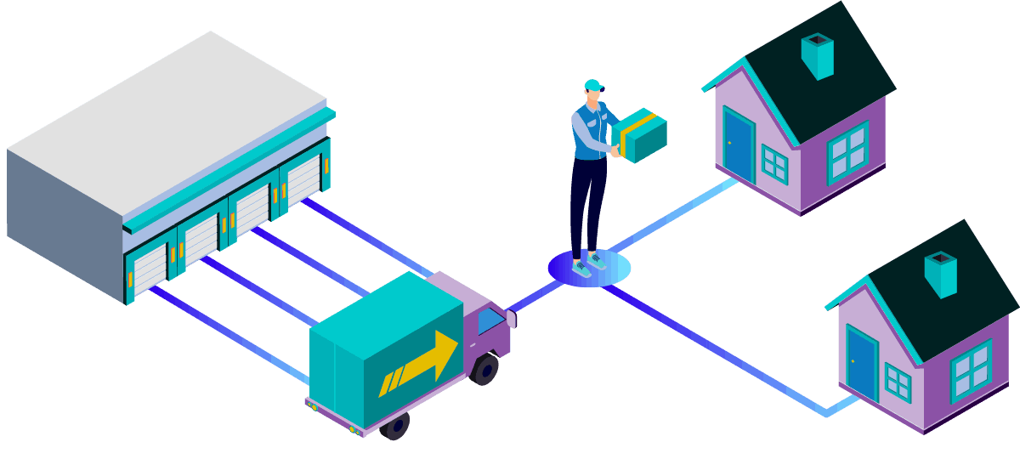
B2C Business Models
The B2C (Business To Consumer) sector is what most people think of when they imagine an ecommerce business. This is the deepest market. B2C sales are the traditional retail model, where a business sells to individuals, but business is conducted online as opposed to in a physical store.

Slide 15
B2C Business Models
E-tailer
Community providers create communities for like minded people (social networks eg. Facebook)
Content provider disseminate info (CNN, ESPN etc)
Portal enable searching to provide info (Yahoo, Google)
Transaction broker (E*TRADE, Hotels.com, Travelocity)
Market creator creates market spaces (Ebay, Amazon)
Service provider (Gmail, Verizon, PayPal, VisaNow.com)

Slide 16
B2C Models: E-tailer
Online version of traditional retailer (Amazon, Walmart, Macys)
Revenue model: Sales
Variations:
Virtual merchant : Operates without any ties to physical locations (online bank, Amazon, )
Catalog merchant: Operates both Physical and online (home shopping network)
Sells large variety of household and personal products
Bricks-and-clicks
Manufacturer-direct
Low barriers to entry

Slide 17
B2C Models: Community Provider
Provide online environment (social network) where people with similar interests can transact, share content, and communicate
Examples: Facebook, LinkedIn, Twitter, Pinterest
Revenue models:
Typically hybrid, combining advertising, subscriptions, sales, transaction fees, and so on

Slide 18
B2C Models: Content Provider
Digital content on the Web:
News, music, video, text, artwork
Revenue models:
Subscription; pay per download (micropayment); advertising; affiliate referral
Variations:
Syndication- firm does not own material just distributes it (newspaper horoscopes and crossword puzzles are syndicated content)
Web aggregators (shopping.com, Travelocity, Priceline) aggregate info and add value to it
For instance, shopping.com collects information on the prices of thousands of goods online, analyzes the information and presents users with tables showing the range of prices and web locations. Shopping.com adds value to content it aggregates, and re-sells this value to advertisers who advertise on its site.

Slide 19
B2C Business Models: Portal
Searching capability plus an integrated package of content and services
Portals such as Yahoo, MSN/Windows Live , and AOL offer users powerful web search tools as well as an integrated package of content and services, such as news, email, instant messaging, calendars, shopping, music downloads, video streaming and more, all in one place.
Portals do not sell anything directly.
Revenue models:
Advertising, referral fees, transaction fees, subscriptions
Variations:
Horizontal/general includes all internet users
Vertical/specialized (vortal) provides a directory of links to information related to a particular industry or subject matter
Searching capabilities

Slide 20
B2C Models: Transaction Broker
Salesperson does not represent either party but handles the transaction only are known as transition brokers.
Middleman roles of facilitating search, contract, regulation and maintenance
In E-commerce, Sites that process transitions for consumers normally handled in person, by phone, or by mail are transition brokers.
Process online transactions for consumers
Primary value proposition—saving time and money, and enabling online transactions (stocks, credit card and PayPal payments)
Revenue model:
Transaction fees
Industries using this model:
Financial services
Travel services and entertainment
Job placement services

Slide 21
B2C Models: Market Creator
Create digital environments where buyers and sellers can meet and transact business
Examples:
Priceline
A prime example is Priceline, which allows consumers to set the price they are willing to pay for various travel accommodations and other products (some times referred to as a reverse auction)
eBay
eBay, the online auction site utilized by both businesses and consumers.
Revenue model:
Transaction fees, fees to merchants for access

Slide 22
B2C Models: Service Provider
Online services
Example: Google—Google Maps, Gmail, and so on
Value proposition
Valuable, convenient, time-saving, low-cost alternatives to traditional service providers
Revenue models:
Sales of services, subscription fees, advertising, sale of marketing data

Slide 23
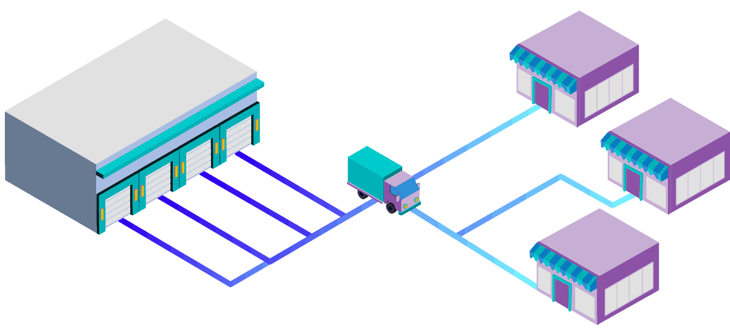
B2B Business Models
A B2B model focuses on providing products from one business to another. While many businesses in this niche are service providers, you’ll find software companies, office furniture and supply companies, document hosting companies, and numerous other ecommerce business models under this heading.

Slide 24
B2B Business Models
B2B relies on EDI (electronic data interchange)
Net marketplaces
E-distributor
E-procurement
Exchange
Industry consortium
Private industrial network

Slide 25
B2B Models: E-distributor
Companies that supply products and services directly to individual businesses are e-distributors.
Version of retail and wholesale store, MRO goods, and indirect goods
Owned by one company seeking to serve many customers
With e-distributors, the more products and services a company makes available on its site, the more attractive that site is to potential customers.
One stop shopping is always preferable to having to visit numerous sites to locate a particular part or products.
Revenue model: Sales of goods
Example: Grainger.com

Slide 26
MRO
MRO - Maintenance, Repair and Operations
Supplies consumed in the production process but which do not either become part of the end product or are not central to the firm's output.
MRO items include consumables (such as cleaning, laboratory, or office supplies), industrial equipment (such as compressors, pumps, valves) and plant upkeep supplies (such as gaskets, lubricants, repair tools), and computers, fixtures, furniture, etc.

Slide 27
B2B Models: E-procurement
Creates and sells access to digital markets where participants transact for indirect goods
B2B service providers, application service providers (ASPs)
Revenue model:
Service fees, supply-chain management, fulfillment services
Example: Ariba- system provides sellers with the ability to manage catalogs, bids, purchases and invoices and provides buyers with the ability to search for suppliers, negotiate savings, procure goods and services and track spending.
http://www.ariba.com/about/our-story

Slide 28
B2B Models: Exchanges
Independently owned vertical digital marketplace where hundreds of suppliers meet a small number of large commercial purchasers
Revenue model: Transaction, commission fees
Create powerful competition between suppliers
Tend to force suppliers into powerful price competition; number of exchanges has dropped dramatically
Example, Walmart has the ability to negotiate the best prices in the industry

Slide 29
B2B Models: Industry Consortia
About 15,100,000 results (0.63 seconds)
Search Results
ICAMR: International Consortium for Advanced Manufacturing Research
About 15,100,000 results (0.63 seconds)
Search Results
ICAMR: International Consortium for Advanced Manufacturing Research
Industry-owned vertical digital marketplace open to select suppliers
More successful than exchanges
Sponsored by powerful industry players
Strengthen traditional purchasing behavior
Revenue model: Transaction, commission fees
Example: Exostar used by defense industry - http://www.exostar.com/Mission/

Slide 30
Private Industrial Networks
Digital network used to coordinate among firms engaged in business together
Represents 75% of B2B business by large firms
Often owned by a large network firm
Example: Walmart’s network for suppliers
Cost absorbed by network owner and recovered through production and distribution efficiencies

Slide 31
Difference between Exchange, Consortia, Private Industrial Network
Exchange | Consortia | Private Industrial Network
Hundreds of suppliers meet small number of large buyers Generate revenue by a commission or fee based on the size of the transaction Usually serve a single industry | Is industry owned Serves a vertical marketplace | Coordinate the flow of communications among firms doing business together Participation is by invitation only Walmart operates the largest private network

Slide 32
Business Models in Emerging E-commerce Areas
M-commerce (mobile commerce):
Takes traditional e-commerce models and leverages emerging new wireless technologies to permit mobile access to the web.
Wireless web technology will be used to enable the extension of existing web business models to service the mobile work force and consumer of the future.
Wireless networks utilize newly available bandwidth and communication protocols to connect mobile users to the internet.
Technology platform continues to evolve
The key technologies here are cell phone based 3G (third – generation wireless) Wi-Fi(wireless local area networks), and Bluetooth (short-range radio frequency web devices).
In the United States, demand still highest for digital content like ring tones, games and wallpaper
Revenue Model
M-commerce business models that hope to rely on push advertising.

